Slide 1




SMARTIE – Secure and Smarter Cities Data Management
Vedran Semenski (75345)
Supervisor: Óscar Pereira
Co-supervisor: Ricardo Azevedo Pereira

Slide 2
Motivations
Be part of a big “European” project
Learning (NoSQL Databases, Access Controll)
Practical (“Real World”) implementation

Slide 3




SotA
IoT and M2M
BigData – NoSQL
Access Controll – ABAC
SMARTIE

Slide 4
Quick description
SMARTIE – Inovação e Sistemas is one of the partners
Framework - (IoT) to collect and share large volumes of heterogeneous sensor information (Big Data) to be used in smart-cities applications
Security component is necessary

Slide 5
Objectives
Sensor data storage
Security policy storage
Conceptual, logical and physical models for both databases
Build a security framework based
ABAC, XACML/JSON

Slide 6
Access Controll
RBAC – role based a.c.
ABAC - attribute based a.c.

Slide 7


ABAC
Attributes:
Subject - User
Object - Resource
Environment

Slide 8
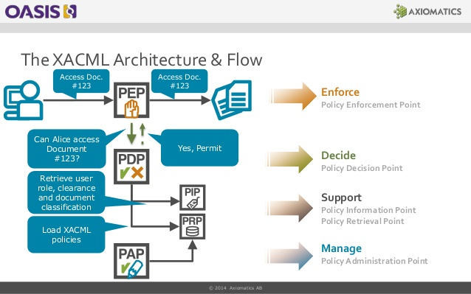
Architecture

Slide 9
NoSQL
Features:
Types:
Scalability
Functionality not available in conventional RDBMS
Key-value
Wide-column
Document
Graph

Slide 10
SMARTIE
Frankfurt/Oder (GER)
Traffic management with the possibility to influence real traffic.
Focus on authentication, trust, data security, interoperability
Murcia (ES)
Monitoring energy efficiency in the campus
Users can interact with the system to improve energy efficiency.
Belgrade (RS)
Provide smart transportation using location of busses and travelers
Focus on data security and privacy using developed access rights and policies

Slide 11
Basic Concept
Modular solution
Scaled down feature set
Independent solution
Testing and evaluating
Integrating in SMARTIE (SmartData) and testing

Slide 12
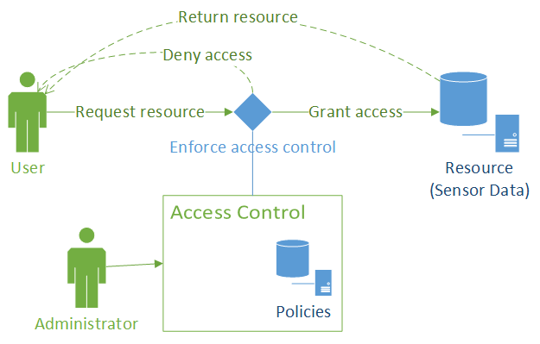
General Architecture

Slide 13
Current state
SotA - almost finished
General Architecture - done
Databases – setup phase
Access Control - initial phase
Testing, evaluating, refactoring, expanding
Writing
Defence

Slide 14
Questions?

